Slide 1
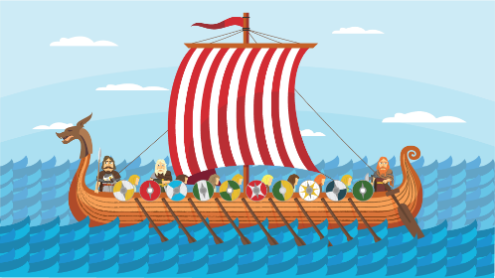
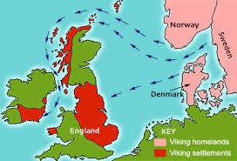
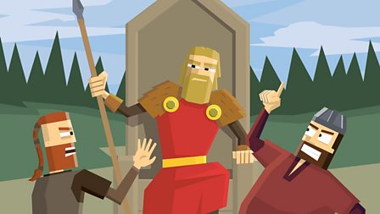
Year 6 History/ Geography – Were the Vikings always victorious and vicious?
English
Non – chronological report about the Anglo – Saxons
Fiction – Charge of the Light Brigade
Class text - Viking Boy
Maths
Equivalent, converting, simplifying and comparing fractions
Adding, subtracting and multiplying fractions
Science
Can you light up your life? (Light)
Art
Printing (Anglo –Saxon art)
PE
Dance
Music
City music – singing
RE – Judaism
PSHE
Families and friendships
Safe relationships
Respecting ourselves and others
ICT
Programming a screen turtle
French
I’m looking for the pirate
Historical Vocabulary
Civilisation, settlers, early, BC, AD, ancient, archaeologist, excavate, artefacts
Previous Learning
Changes within living memory
Victorians
The role of an archaeologist Prehistoric Britain
Ancient Greece
Ancient Egypt
The Romans
The Vikings
Geographical Vocabulary
Rivers, mountains, coast, ocean, sea, continent, country, city, capital, climate, vegetation belt, trade, food, water.
Maths Vocabulary
Factor, common factor, common multiple, Multiple, prime, composite, squared, cubed, Order of operations, brackets, inverse.
Key learning
Know which century Vikings arrived in Britain and why they settled.
Name and locate the places Vikings came from on a world map, making links to continents, countries and seas.
Explain what life during the Viking period was like, including jobs, food, clothing and art.
Explain the importance of religion during the Viking period.
Discuss famous Viking battles and why they are known as fierce warriors.
Explain why Viking long ships were useful in battle.
Compare similarities and differences between Vikings and Anglo-Saxons (Y5).
Explain the impact of the Viking period on Britain and the wider world today.
Explain why the Vikings left Britain.
Weekly Questions
Who were the Vikings?
Why did the Vikings tend to win battles?
How did the Gods influence Viking life?
What was life like in Viking Britain?
What did the Vikings trade?
What happened to the Anglo-Saxons and the Vikings
What happened in 1066?

Slide 2
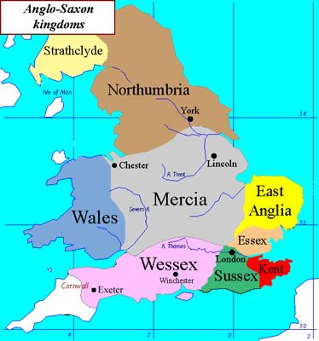
Year 6 History/ Geography – Were the Vikings always victorious and vicious?
Topic Fridge words
Archaeologist - People who discover our history by looking at artefacts that have been found.
Raids - A sudden armed attack with the aim of causing damage rather than occupying any of the enemy's land.
Vicious - To be intentionally harmful or nasty. Vikings warriors were known to be vicious.
Longhouse - A large hall-like building where many Viking families would live together.
Berserkers - Warriors that went to war wearing wolf or bear skins. They were out of control and charged fearlessly. The word ‘berserk’ came from it.
Longship - The narrow boat used by Vikings to raid along coasts.
Odin - One of the most famous Viking Gods known for wisdom.
Scandinavia - The name given to a collection of countries: Denmark, Norway and Sweden.
Danelaw - The name given to lands in Britain occupied by the Vikings.
Misconception - This means misunderstanding. In Viking terms there were many misunderstandings about the Vikings.
Jorvik - The Viking name for the city of York. York now has a famous Viking museum called Jorvik.

